Slide 1


The Fraud Intelligence Engine: A Hybrid Framework Merging Feature Crafting and Comparative Learning”
Cheng-Min Tsai,
Nguyen-Thu Thuy,
Huei-Wen Teng
NYCU
MY SITE
20251208 Project presentation
Notes:
Opening slide
“Hello everyone, and thank you for joining us today. Our project is titled ‘Next-Gen Credit Risk and Fraud Detection with Explainable AI’. This work is a collaboration between Cheng-Min Tsai, Nguyen-Thu Thuy, and Professor Huei-Wen Teng here at NYCU.
In this study, we explore how machine learning — especially explainable AI — can improve the accuracy and interpretability of risk and fraud detection in modern financial systems. As digital finance grows rapidly, traditional models are no longer sufficient, so our goal is to build smarter, more transparent, and more reliable solutions.
Let’s begin.”

Slide 2
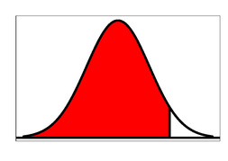
Outline
Motivation ✓
Overview Study Plan
Intro Datasets
Define Credit Fraud
Clean Data
EDA Chart
Conclusion
IDA Template
Notes:
🎤 Outline Slide
“Here is a quick overview of today’s presentation.
We’ll start with the motivation, discussing why credit risk and fraud detection are becoming more challenging in the digital era. Next, I’ll walk through the overall study plan, showing how we structured our approach from data to modeling.
Then, we introduce the datasets, followed by a clear definition of what we consider to be potential fraud behaviors. After that, we move into data cleaning and preprocessing, which is critical for building reliable models.
We then examine several EDA charts to identify unusual patterns in the data. Finally, we wrap up with the conclusion—highlighting key insights and the best-performing model.
Now let’s begin with the motivation.”

Slide 3
Motivation
Motivation
Digital finance creates high-volume, fast-changing credit and fraud risks.
Traditional rule-based and linear models fail to capture complex behavioral patterns.
Fraud schemes evolve quickly and are difficult to detect with static systems.
Regulators require transparency, fairness, and explainable model decisions.
Need models that are both accurate and interpretable for real-world deployment.
This study explores machine learning with explainable AI to improve risk and fraud detection.
IDA Template
Notes:
Digital finance today moves very fast and handles a huge amount of transactions. This brings many advantages, but it also creates new credit risks and smarter fraud behavior. Traditional rule-based systems and basic models cannot keep up anymore, because they cannot understand the complex and quickly changing patterns of real users and fraudsters.
At the same time, financial regulators now require models to be transparent, fair, and easy to explain. So a model cannot only be accurate — it must also be understandable and trustworthy.
Because of this, we need methods that can give strong predictions while still being interpretable.
In this study, I look at how machine-learning models, can improve both risk detection and fraud detection. The goal is to build models that are accurate, flexible, and ready for real financial environments.”

Slide 4
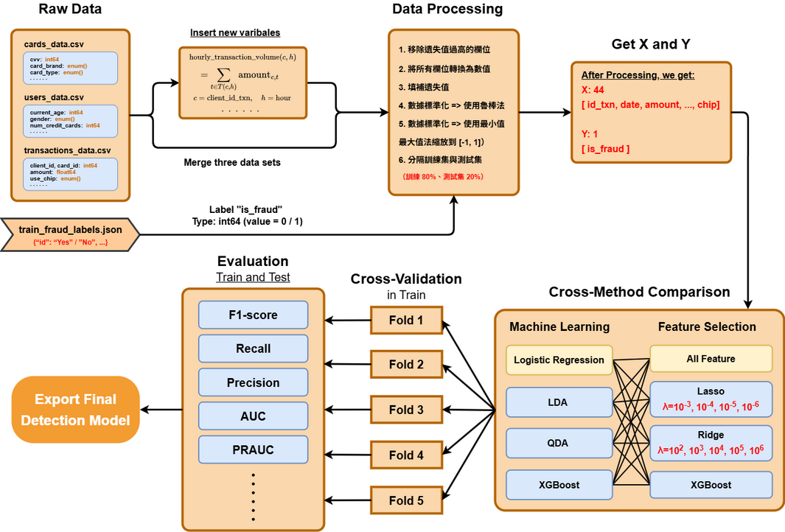
Motivation
Overview Study Plan
Title
Notes:
“Overview Study Plan”
“In this slide, I will give a quick overview of the entire study workflow.
We start with three raw datasets: card information, user profiles, and transaction records, along with the fraud labels. These datasets are merged together, and we also create new variables such as hourly transaction volume to capture behavioral patterns.
Next, the data processing stage includes removing columns with too many missing values, converting all features to numeric, imputing missing entries, and applying both Z-score standardization and Min–Max scaling. After processing, we split the data into an 80% training set and a 20% testing set, and extract our final feature matrix X and target label Y.
Model training involves five-fold cross-validation to ensure stability and avoid overfitting. We compare four machine learning models: Logistic Regression, LDA, QDA, and XGBoost. We also evaluate multiple feature selection methods, including Lasso and Ridge with different regularization strengths.
Finally, we assess all model combinations using F1 score, recall, precision, ROC-AUC, and PR-AUC, and select the best-performing pipeline as our final fraud detection model.”

Slide 5
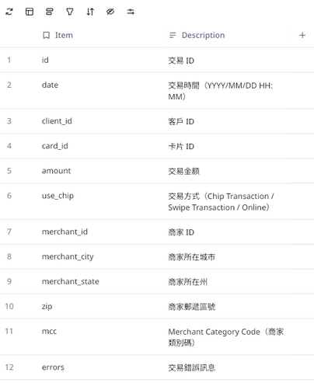
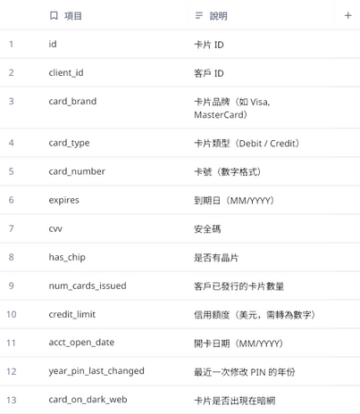
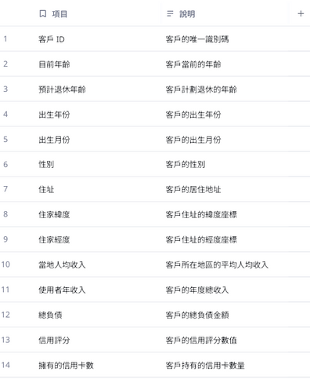
Intro Datasets
Intro Datasets
Teachers datasets on kaggle (Kaggle's Financial Transactions Dataset: Analytics, introduced by Chrissy)
Cards, Transactions, Users
Title
Notes:
Intro Datasets
“For this project, we used the financial transaction datasets that our teacher provided from Kaggle, introduced by Chrissy. The dataset is quite comprehensive and is designed for fraud and credit risk analytics.
It consists of three main tables: Cards, Transactions, and Users. Each table contributes different types of information.
The Cards dataset includes fields such as card ID, card brand, card type, expiration date, and whether the card uses a chip. The Users dataset provides demographic details like age, gender, income, and credit limit. And the largest dataset is Transactions, which contains the actual transaction records including amount, merchant information, transaction method, location, and timestamps.
By combining these three sources, we can capture both behavioral and demographic patterns, which is essential for identifying unusual or potentially fraudulent activities.
Overall, these datasets give us a strong foundation to build machine learning models for fraud detection and credit risk analysis.”

Slide 6
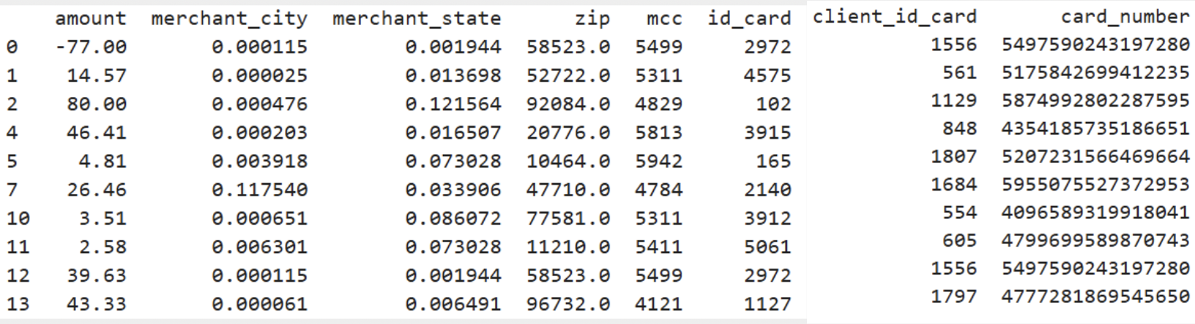
Intro Datasets
Clean the data
There datasets we use is Cards, Transactions, Users
Combine three datasets
Remove unused datas (id_txn', 'card_id', 'merchant_id', 'date' ...)
Remove columns with more than 70% missing values.
Impute missing values with the median
Title
Notes:
“In this study, the dataset contains three main components: card information, transaction records, and user profiles.
The transaction dataset includes fields like transaction ID, date and time, amount, merchant information, and whether the customer used a chip. The card dataset includes details such as card type, brand, expiration date, and security information.
The user dataset provides demographic and behavioral information, including age, gender, income, and credit limit. These three datasets together give us a complete view of customer behavior — who the user is, what card they are using, and how they transact.
All datasets are later merged to form a unified table for fraud detection analysis. This allows the model to learn from both customer attributes and real transaction patterns, which is essential for identifying potential fraud.”

Slide 7
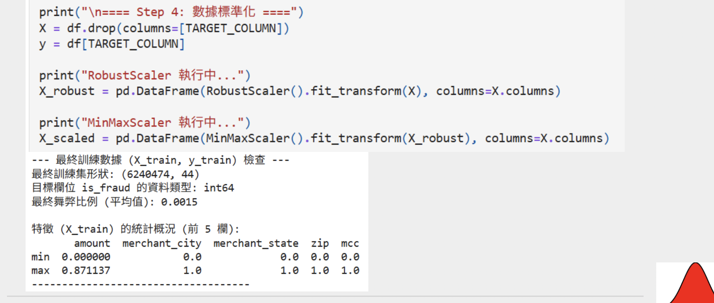
Intro Datasets
Clean the data
Standardize the datas
Robust methods => Standardize the data using the medianand interquartile range (IQR)
Min-Max scaling => Normalize the data to the range 0-1
Notes:
Clean the Data
“In this step, we focus on cleaning and standardizing the dataset to ensure all machine-learning models can learn effectively.
First, we standardize the features. Instead of using the mean and standard deviation, we apply a robust scaling method, which uses the median and interquartile range (IQR). This approach is more resistant to outliers, which is important because real-world datasets often contain extreme values.
After robust scaling, we apply Min-Max scaling to normalize all features into a range between 0 and 1. This keeps different features on the same scale and prevents any single variable from dominating the model due to its magnitude.
The code on the slide shows these two steps: – RobustScaler to handle outliers – MinMaxScaler to compress all values into the 0–1 range
By cleaning and standardizing the data this way, we prepare a stable and consistent training set, which ultimately improves model accuracy and reliability.”

Slide 8
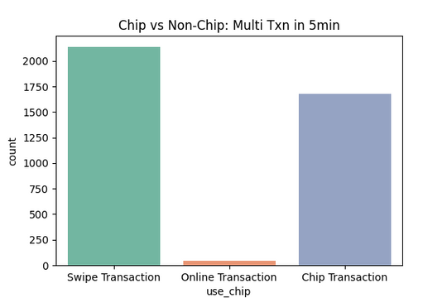
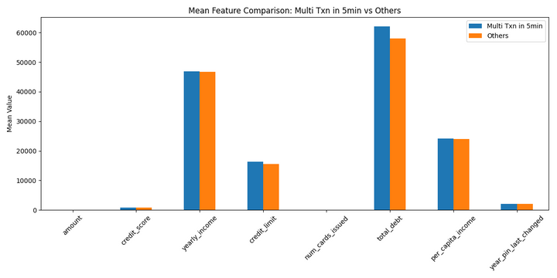
EDA Chart
EDA Chart
Frequent transactions in a short period of time (5min)
Notated these datas in Trans_Data
Measure the difference in these bias data
Title
Notes:
“In this slide, I focus on one of the key behavioral signals of credit fraud: frequent transactions occurring within a very short period of time. In this dataset, we define this as more than three transactions within five minutes. Although this pattern only represents about 0.03% of all transactions, it is an important risk indicator because fraudsters often try to make several purchases quickly before a card gets blocked.
We mark these cases directly in the transaction dataset so that we can compare their characteristics with normal transactions. The chart on the left shows the mean differences of several features. We can observe noticeable shifts in variables such as transaction amount and spending behavior when multiple transactions occur in a short time.
The chart on the right breaks these rapid transactions down by transaction type. Most of them come from swipe transactions and chip transactions, while online transactions make up a very small portion. This makes sense because in physical fraud, the card is often present and used repeatedly.
This early EDA helps us understand how unusual behaviors differ from normal ones and provides useful insights for selecting features for the fraud detection model.”

Slide 9
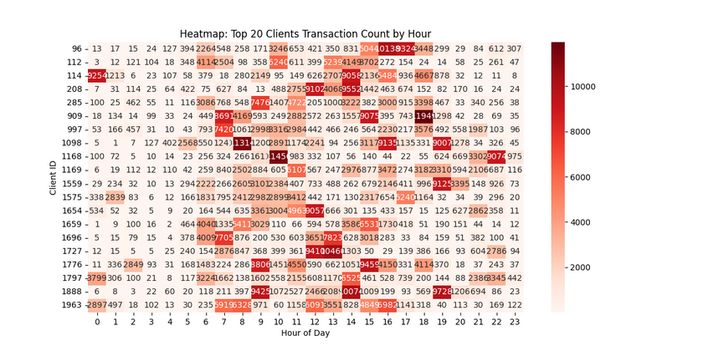
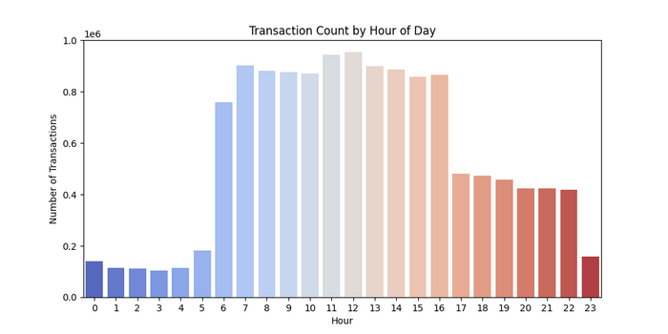
EDA Chart
EDA Chart
About transactions Time
Observe numerous amount at strange time
Client 114
Client 1168
After EDA,
We found the transaction amount every hour is important indication.
Title
Notes:
“EDA Chart – Transaction Time”
“In this slide, I explore how transaction time can indicate unusual or potentially fraudulent activity. The chart on the left shows the overall transaction volume by hour of the day. As expected, most transactions happen during daytime hours, especially between 8 AM and 4 PM. Activity drops significantly late at night, which makes late-night transactions more suspicious because they deviate from normal behavior.
To investigate this further, I created a heatmap showing the hourly transaction patterns of the top 20 most active clients. Each row represents a client, and each column represents an hour of the day. Darker red colors indicate a higher number of transactions.
From this visualization, we can clearly see some clients—such as Client 114 and Client 1168—who show extremely high activity at unusual times, including very late at night or very early in the morning. These patterns stand out compared to typical customers and may signal abnormal or risky behavior.
Understanding these time-based anomalies helps us identify features that could strengthen our fraud detection model, especially in capturing unusual transaction timing. Accroding the result of EDA, we found hourly_transaction_volume is important indication for this mode

Slide 10
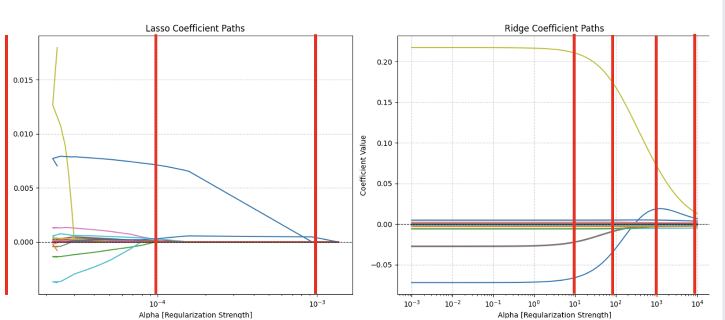
Feature selection
Feature selection
Use All Features, Ridge, Lasso, and XGBoost
To find best alpha (λ) in Ridge and Lasso, we draw the chart
Title
Notes:
Feature Selection Slide
“In this slide, I show how feature selection was performed using Lasso and Ridge regularization. Both methods help us control model complexity by shrinking the coefficients toward zero as the regularization strength increases.
On the left is the Lasso coefficient path. As alpha becomes larger, many coefficients drop exactly to zero. This is because Lasso performs both regularization and feature selection at the same time. It automatically removes weak or irrelevant features, which is very helpful in reducing noise and simplifying the model.
On the right is the Ridge coefficient path. Ridge also shrinks coefficients but does not set them to zero. Instead, it keeps all features but reduces their magnitude smoothly. This helps stabilize the model, especially when there is multicollinearity.
By examining these coefficient paths across different alpha values, we can identify which features remain important under strong regularization. These results guide us in selecting feature sets for our later machine learning experiments.”

Slide 11
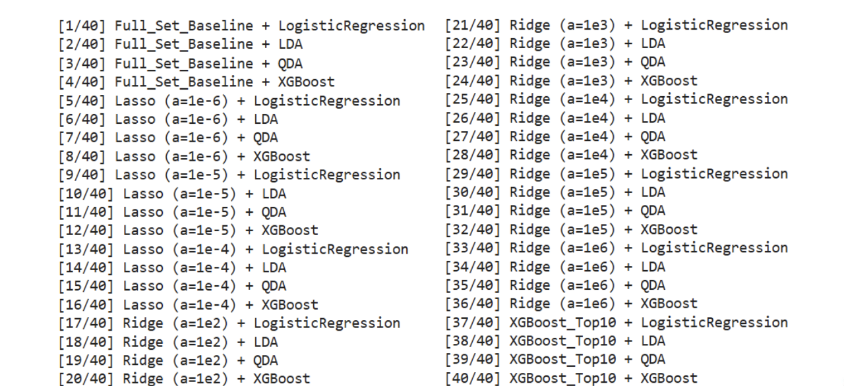
Model Evaluation
Model Training
choose four Machine Leaning Method
Finally, We cross 4 ML and 10 Feature sets => 40 combinations
Notes:
⭐ Model Training Slide)
“Next, let’s look at how we trained and evaluated our models.
To ensure robustness, we selected four different machine-learning algorithms: Logistic Regression, LDA, QDA, and XGBoost. We also created 10 different feature sets, including baseline full-set features, Lasso-selected features, Ridge-selected features, and Top-10 optimized features.
We then performed a full cross-combination between the models and the feature sets. That means: 4 machine-learning methods × 10 feature sets = 40 total model combinations.
Each combination was trained, validated, and compared to identify the best-performing setup. This approach ensures that instead of relying on a single model, we systematically explore the entire design space to find the most accurate and stable predictive model.
In summary, we tested 40 configurations, allowing us to confidently select the strongest model for deployment.”

Slide 12
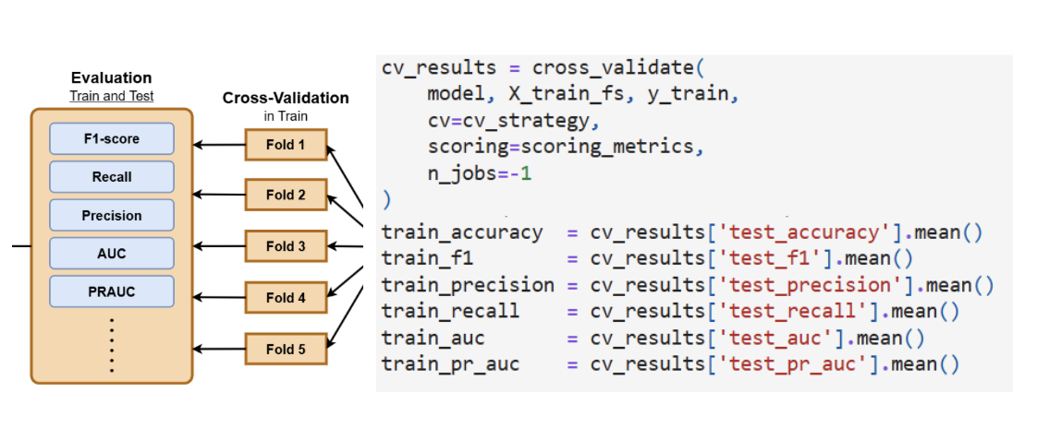
Model Evaluation
Model Training
Model Evaluation
Model Training - Cross Validation
For training evaluation, we use 5-fold CV, and get the average.
=> The result is become more reliable
Notes:
Model Training (Cross Validation)
“In the model training phase, our priority was to make sure the results are reliable and not dependent on just one random split of the data.
To achieve this, we used 5-fold cross validation. This means we divide the training data into five equal parts. In each round, the model trains on four parts and validates on the remaining one. We repeat this process five times so every data segment is used once for validation.
After running all five folds, we take the average performance—including accuracy, F1-score, precision, recall, AUC, and PRAUC. This averaging helps smooth out fluctuations and gives us a more stable and trustworthy estimate of how the model will perform in real-world situations.
By applying 5-fold cross validation to all our model combinations, we ensure that the final selected model is not only accurate, but also consistent and robust across different data samples.”

Slide 13
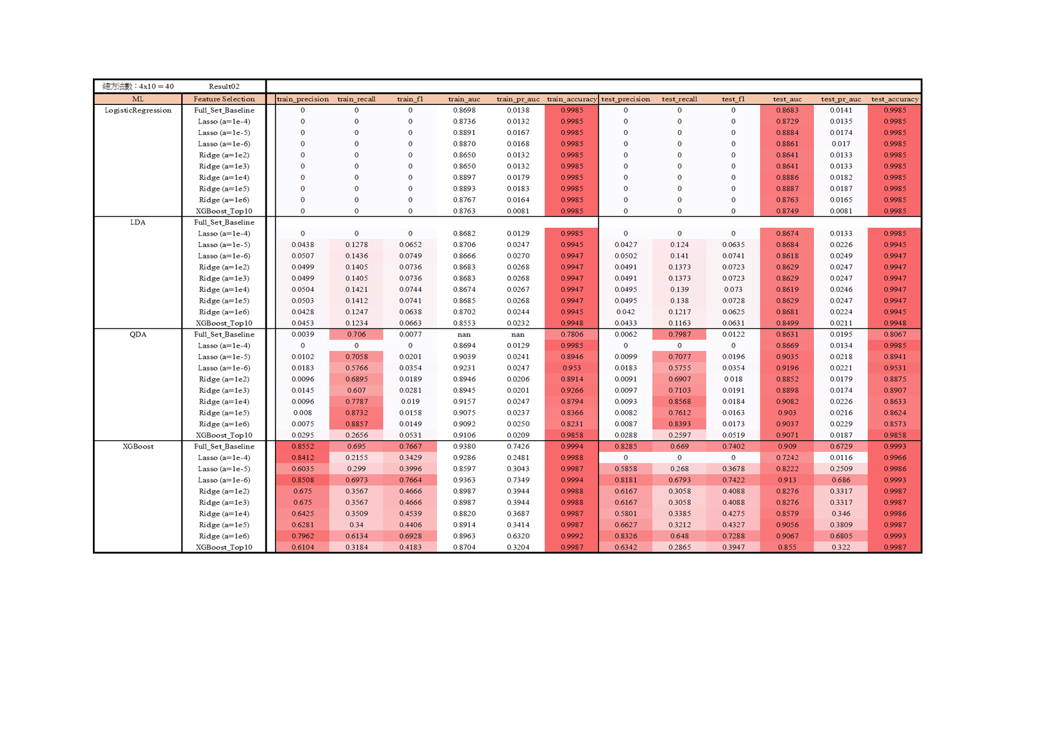
Model Training
Model Training
Title
Notes:
Model Training Slide
“This slide shows the results of training different machine learning models under multiple feature selection settings. The table compares Logistic Regression, LDA, QDA, and XGBoost across various Lasso and Ridge regularization strengths.
From the training and test metrics, we can clearly see that the classical linear models — Logistic Regression, LDA, and QDA — struggle with this dataset. Most of them produce extremely low test F1 scores, mainly because their recall is close to zero. This suggests that these models cannot effectively capture the complex, nonlinear patterns present in fraud detection.
In contrast, XGBoost consistently performs much better. When combined with the right feature selection strategy, especially Lasso with very small alpha, the model achieves significantly higher precision, recall, and F1. This shows that tree-based boosting methods are more suitable for this type of problem, where behaviors and relationships are not linear.
These results help us narrow down the best model configurations and lead directly to the model comparison and selection in the next slides.”

Slide 14
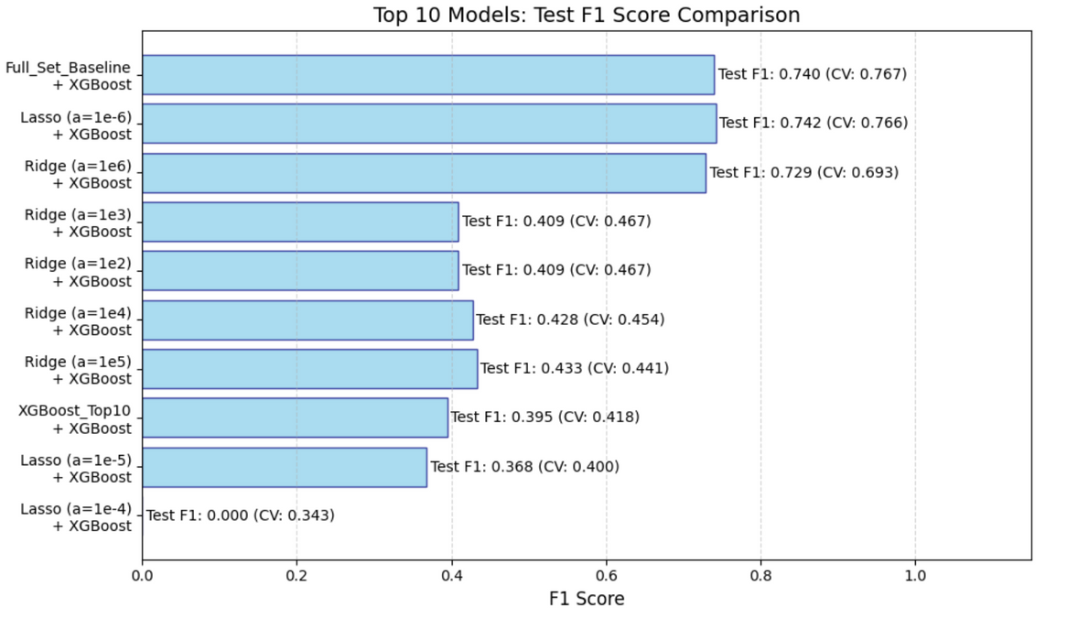
Model Evaluation
Model Evaluation
Title
Notes:
Model Evaluation (Top 10 F1 Scores)
“This slide shows the Top 10 best-performing model configurations based on Test F1 score. The F1 score is especially important in fraud detection because it balances precision and recall, helping us capture fraudulent cases while avoiding too many false alarms.
From the chart, we can see that XGBoost consistently outperforms the classical models across all feature selection settings. The highest performance comes from two pipelines: the full feature set with XGBoost, and Lasso with alpha equal to 1e-6 combined with XGBoost. These two models achieve Test F1 scores of around 0.74, with strong cross-validation scores as well, showing excellent stability and generalization.
Ridge-based models perform moderately well, with F1 scores around 0.40 to 0.43, but they are still far below the XGBoost models. Meanwhile, the worst performance comes from Lasso with higher regularization values, where too many features are removed and the model collapses.
Overall, this ranking clearly shows that the combination of careful feature selection and a strong nonlinear model like XGBoost is the most effective strategy for this fraud detection task

Slide 15
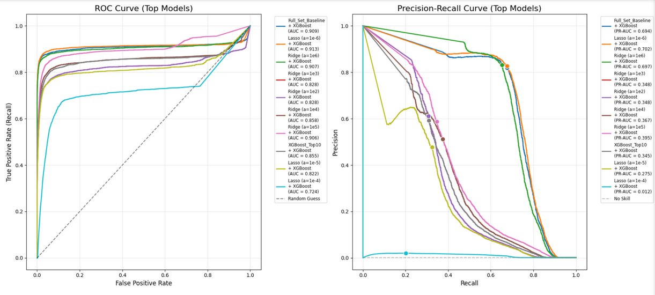
Model Evaluation
Model Evaluation
Title
Notes:
Model Evaluation (ROC & PR Curves)
“This slide gives us a deeper look into model performance using ROC curves and Precision–Recall curves. ROC curves measure the ability to distinguish between fraud and non-fraud cases, while PR curves are especially important for imbalanced datasets like ours.
Looking first at the ROC curves, the best models cluster near the top-left corner, with AUC values around 0.90 or higher. This indicates excellent discriminative ability. Lasso with very small alpha and the full XGBoost model both achieve the strongest results, confirming what we saw earlier with the F1 scores.
The Precision–Recall curves offer an even more realistic view. Fraud cases are rare, so PR-AUC tells us how well the model performs under imbalance. Here again, the XGBoost models clearly dominate, especially the Lasso-selected version with alpha = 1e-6. These models maintain high precision over a wide range of recall values, meaning they accurately identify fraud while minimizing false positives.
On the other hand, classical models and poorly tuned feature selection methods show much weaker curves. This reinforces the conclusion that tree-based boosting methods paired with thoughtful feature selection are the best choice for this dataset.”

Slide 16
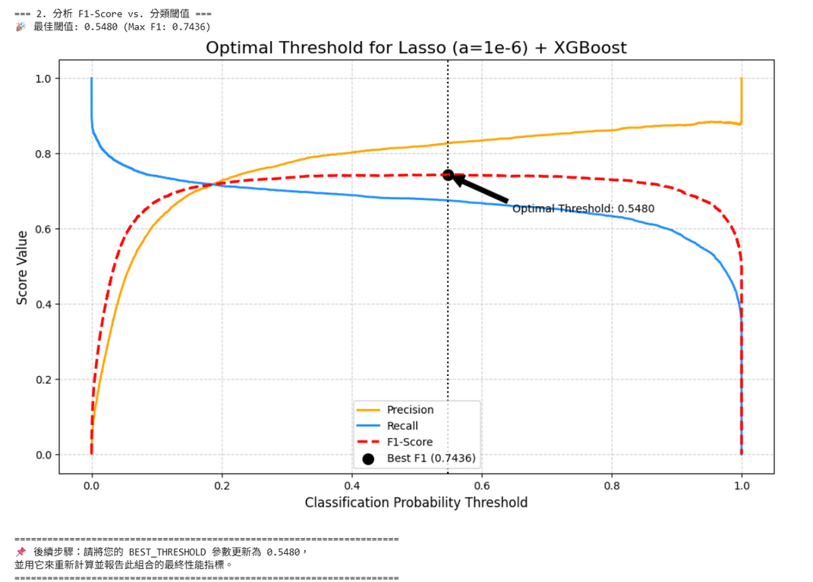
Best Model
Best Model
Best Model => Lasso (a=1e-6) + XGBoost
Title
Notes:
Best Model (Lasso + XGBoost)
“This slide shows the performance of the best model identified in the study: XGBoost combined with Lasso feature selection using alpha equal to 1e-6. After evaluating all model configurations, this pipeline achieved the highest F1 score, making it the most effective for detecting fraud.
The chart here shows how precision, recall, and the F1 score change as we adjust the classification threshold. Instead of using the default threshold of 0.5, we tuned the threshold to find the point that gives the best balance between precision and recall. This is very important in fraud detection, because increasing precision reduces false alarms, while increasing recall helps us catch more fraud cases.
The optimal threshold for this model is approximately 0.548, where the F1 score reaches its maximum of 0.7436. This indicates that the model performs better when we slightly shift the decision boundary rather than relying on the default value.
Overall, this result highlights two key ideas: first, Lasso helps remove noisy features and improves model stability; second, XGBoost effectively captures complex patterns in the data. And finally, tuning the classification threshold significantly boosts real-world performance.”

Slide 17
Conclusion
Conclusion
Feature selection improved performance
Lasso (α = 1e−6) removed weak features and boosted generalization.
Classical models underperformed
Logistic, LDA, QDA had very low F1 → task is highly non-linear.
XGBoost was the best overall
Highest F1, ROC-AUC, and PR-AUC across all feature sets.
Best pipeline: Lasso (1e−6) + XGBoost
Test F1 = 0.7436 (CV ≈ 0.767) → strong and stable model.
Strong model evaluation
ROC-AUC ≈ 0.913 and solid PR-AUC on imbalanced data.
Threshold tuning improved results
Optimal threshold 0.548 boosted F1 and precision–recall balance.
Title
Notes:
Conclusion Slide
“To conclude, this study shows that feature selection and model choice play a major role in improving fraud detection performance. Lasso, particularly with a very small regularization parameter, was effective in removing weak features and improving generalization.
In contrast, classical models like Logistic Regression, LDA, and QDA performed poorly across all settings. Their very low F1 scores and recalls indicate that the fraud detection task is highly nonlinear and cannot be captured well by linear decision boundaries.
XGBoost was the strongest model overall. It consistently produced the highest F1 scores, ROC-AUC, and PR-AUC across all feature sets. The best pipeline was Lasso with alpha = 1e-6 combined with XGBoost, achieving a Test F1 of 0.7436 and stable cross-validation performance.
Model evaluation metrics confirmed the robustness of this approach. ROC-AUC reached approximately 0.913, and PR-AUC remained strong despite the dataset imbalance.
Finally, threshold tuning further improved predictive performance. Setting the probability threshold to 0.548 increased the F1 score and provided a better precision–recall balance. Altogether, these results show a clear path to building an accurate and reliable fraud detection system.”

Slide 18
Next-Gen Credit Risk and Fraud Detection with Explainable AI
Cheng-Min Tsai,
Nguyen-Thu Thuy,
Huei-Wen Teng
NYCU
MY SITE
20251013 Project presentation

